Slide 1


SAP UI5 & FIORI with OData TRAINING
Anubhav Oberoy & Nishan Nainsukha
Day – 17

Slide 2

Agenda – Day 17
Connectivity: Role of SCC
Connectivity
Destination
BAS Fiori App Integration with OData

Slide 3

Connectivity: Role of SCC
Internet
Intranet
SAP BW
SAP ECC
SAP S/4 Hana
SAP BTP (PublicCloud)
SAP On-premise System
SAP Business Application Studio
SCC
Destination
S/4 Hana Cloud
Field Glass
Sales Force

Slide 4
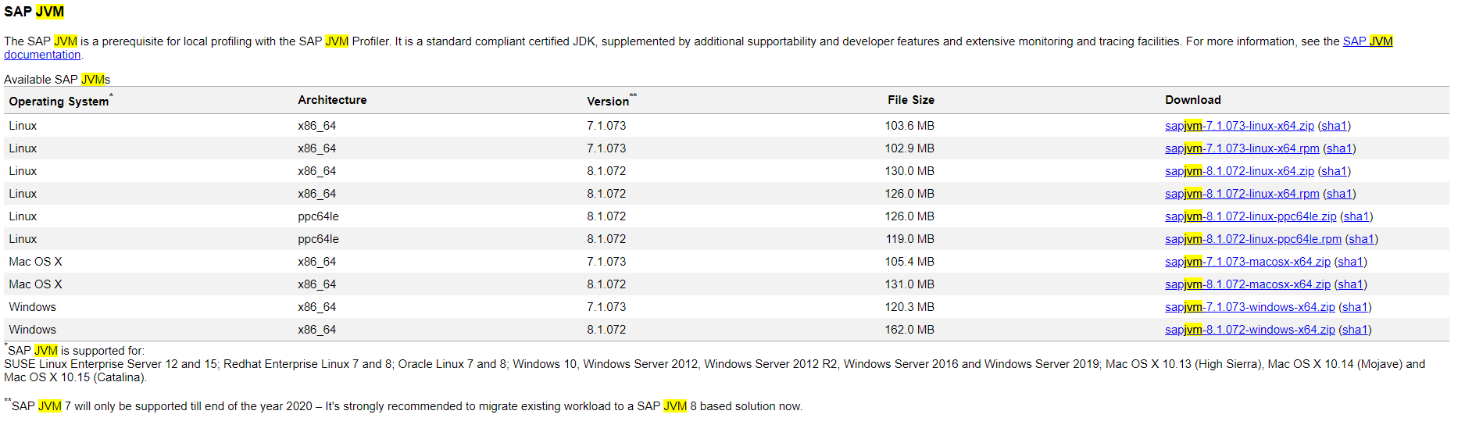
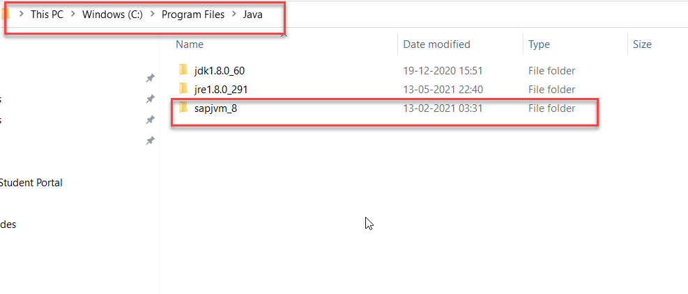
Connectivity
Step1: Download SAP JVM and Extract it in the C:\Program Files\Java

Slide 5
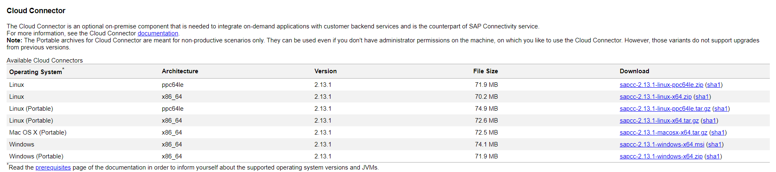
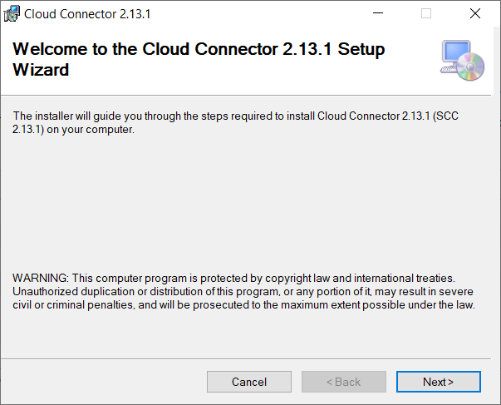
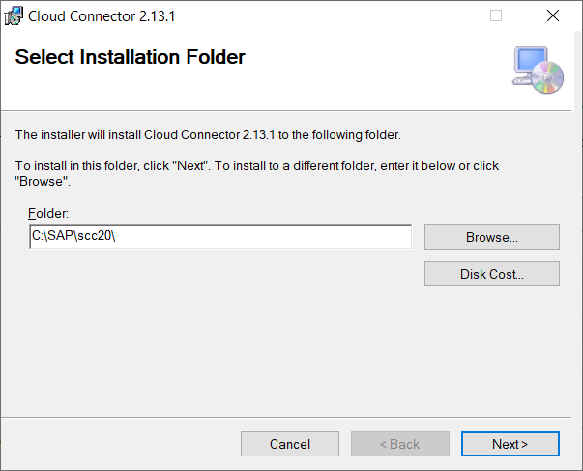
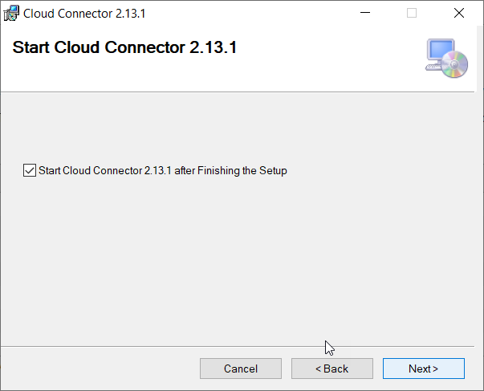
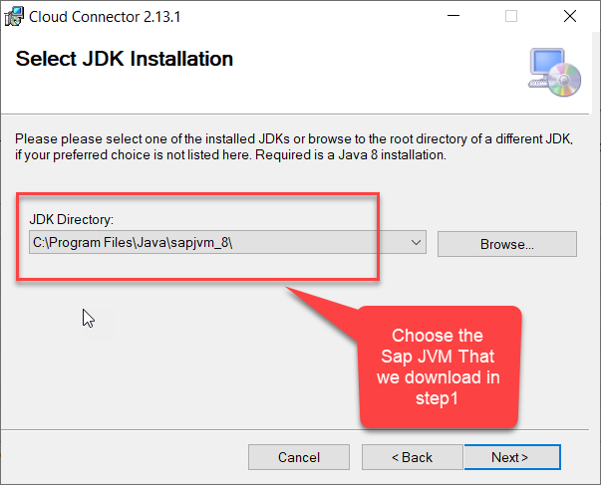
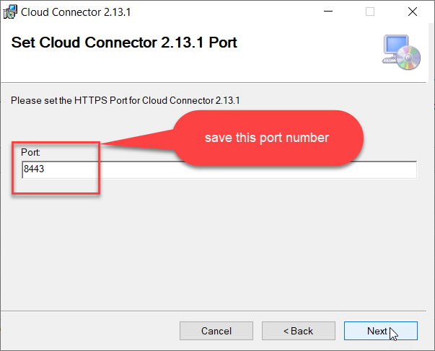
Connectivity
Step2: Download and install the sap Cloud connector

Slide 6
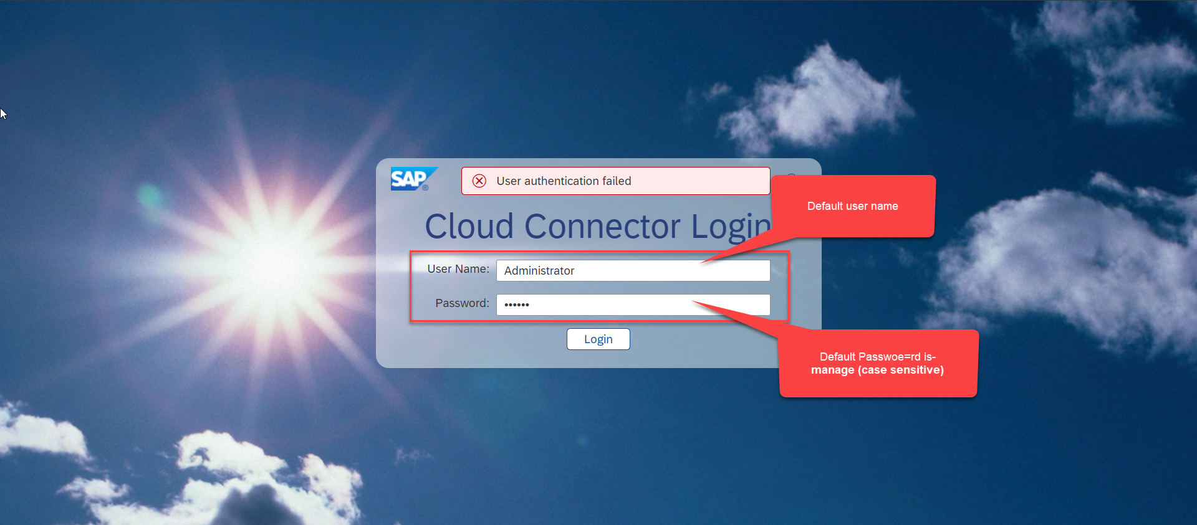
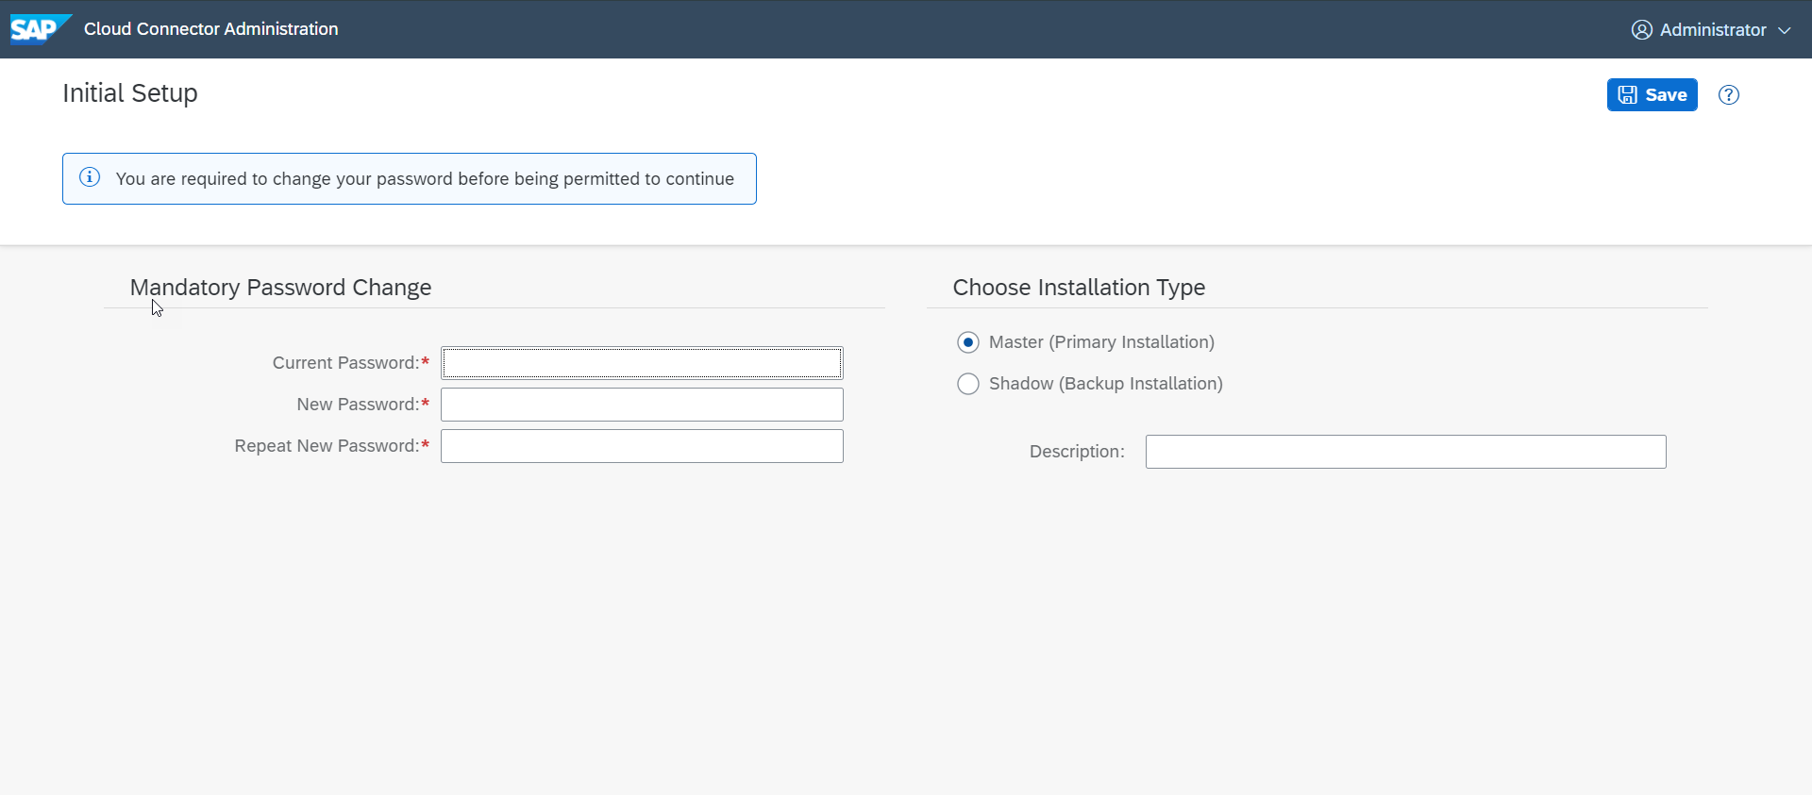
Connectivity
Step3: Now your system is ready go to browser and open https://localhost:8443 (port may changes)

Slide 7
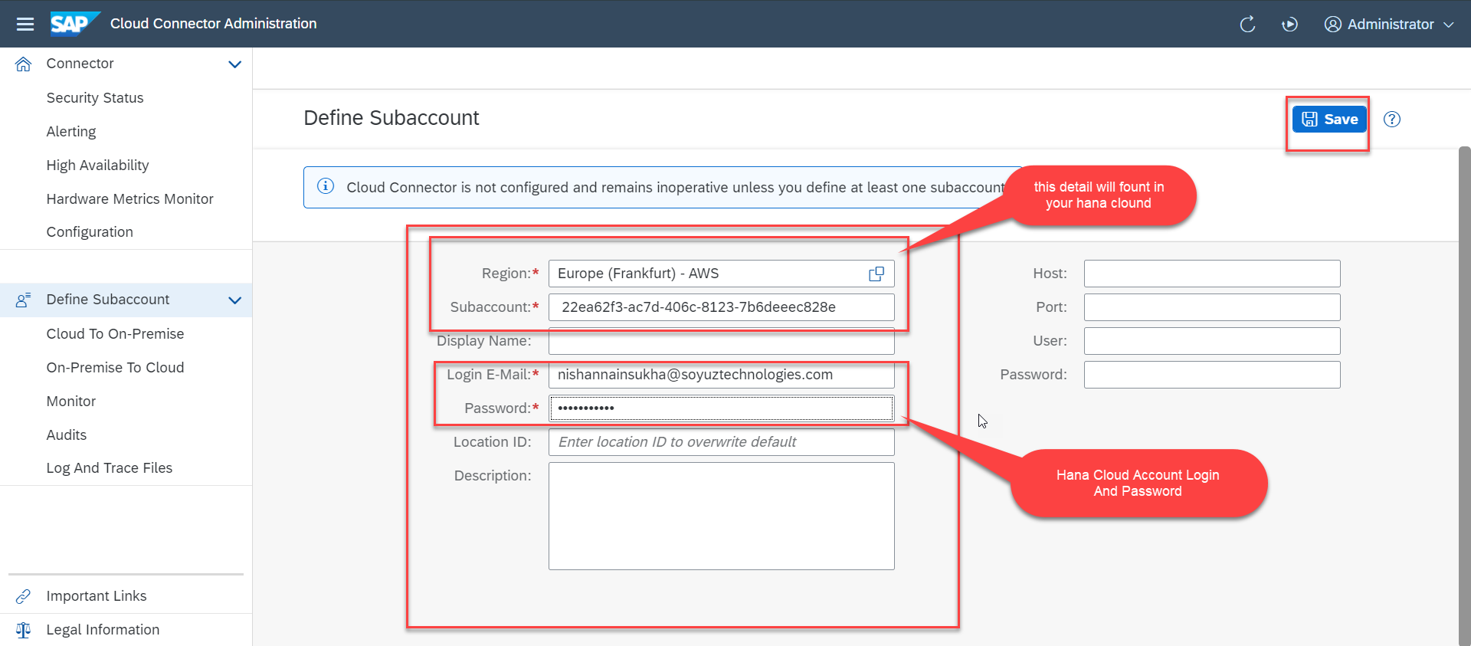
Connectivity
Step4: Now we create a connection with our Cloud Account

Slide 8
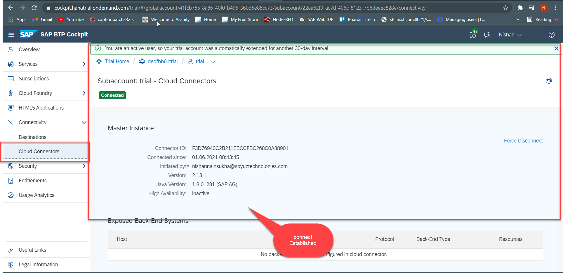
Connectivity
Step4: Check the connection on Hana Cloud Account

Slide 9
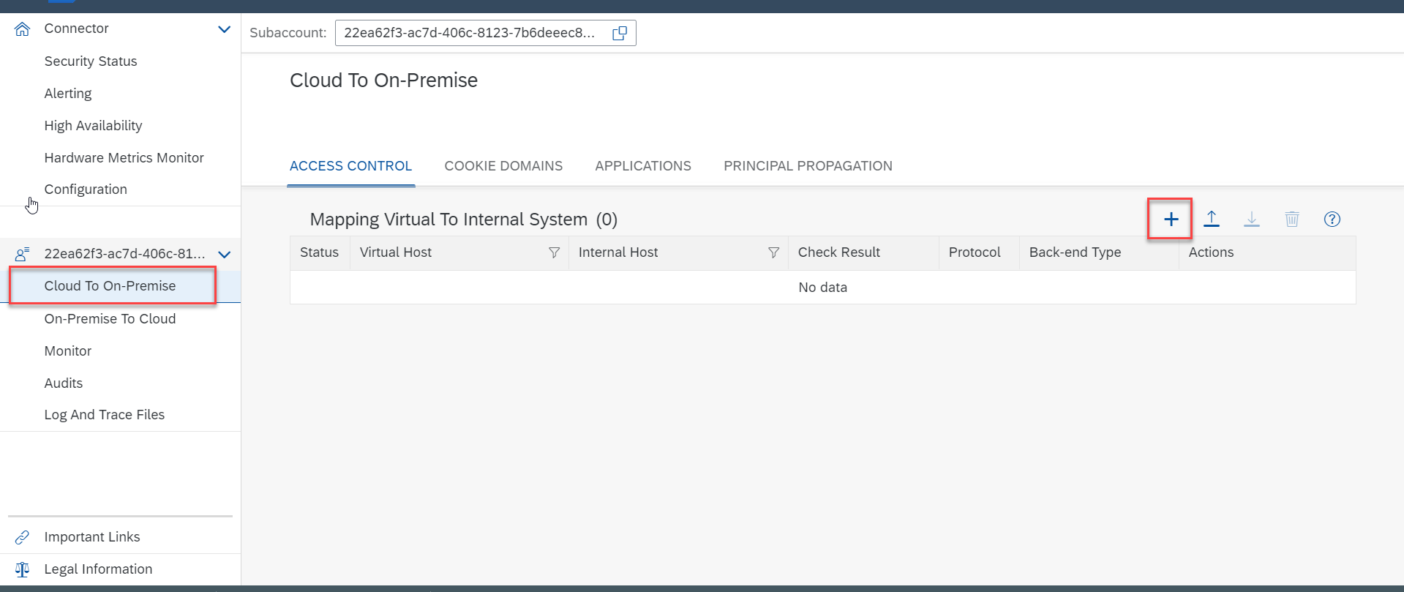
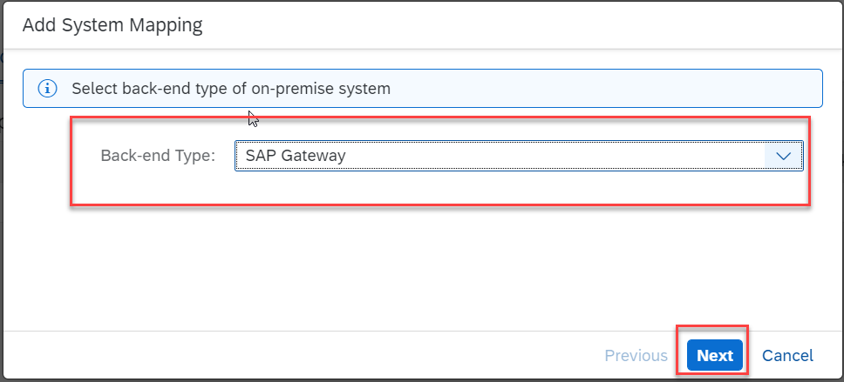
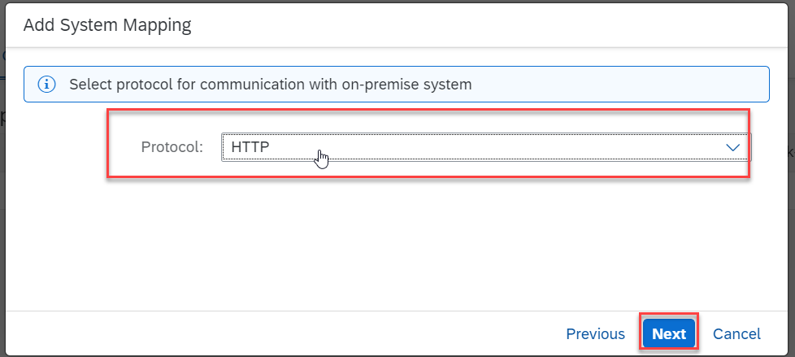
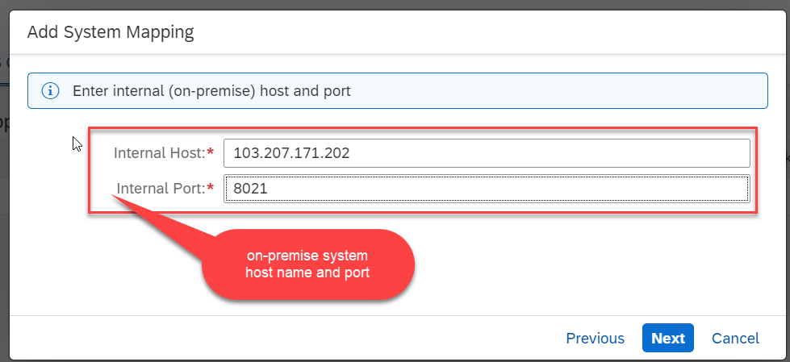
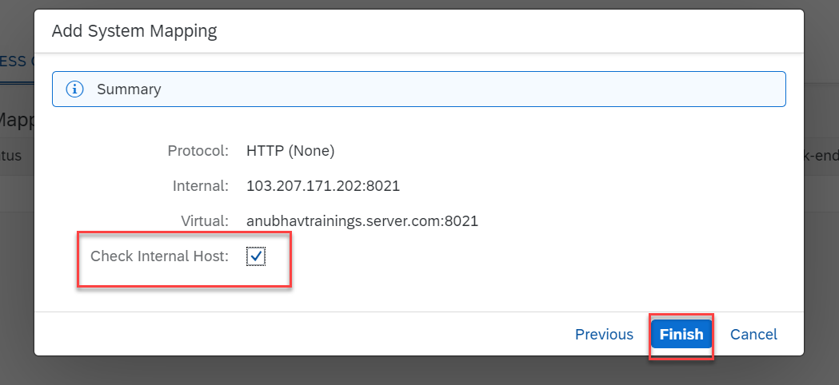
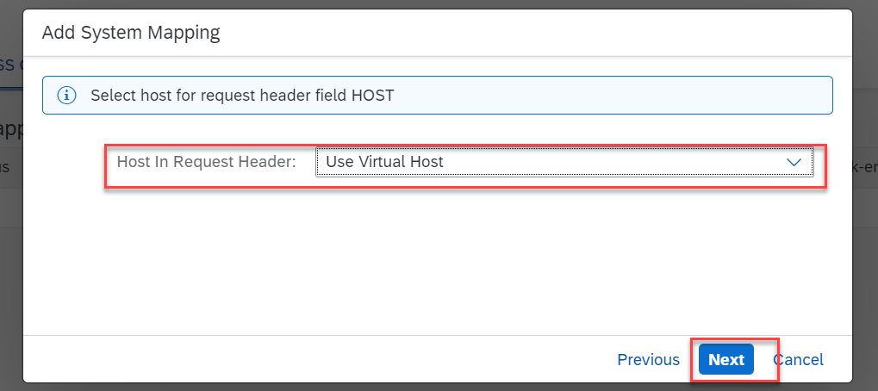
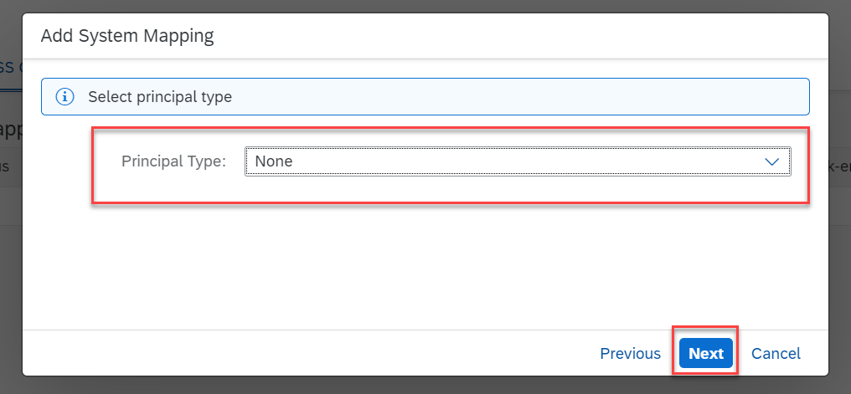
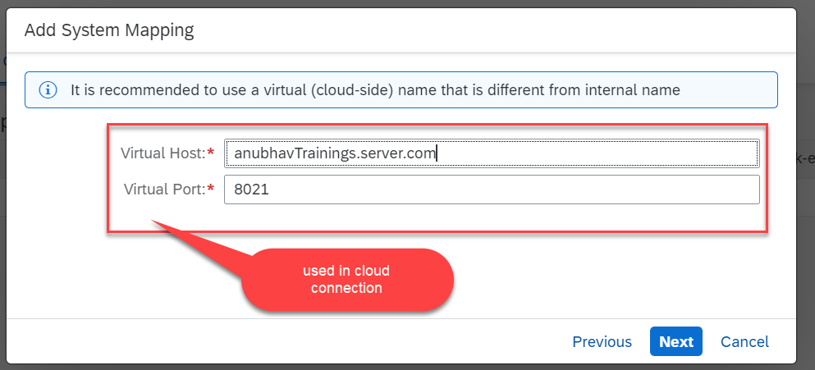
Connectivity
Step5: Connect on-premise system to cloud using SCC

Slide 10
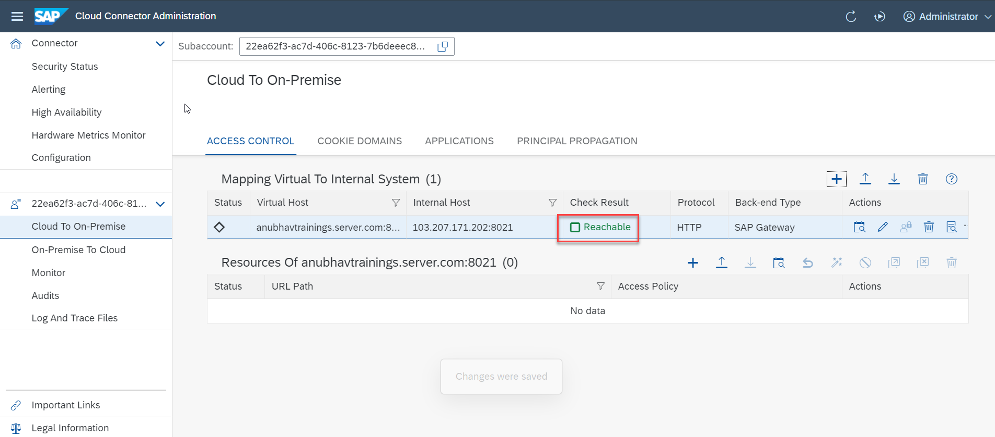
Connectivity
We Done with Connect , now we are connected with cloud using SCC

Slide 11
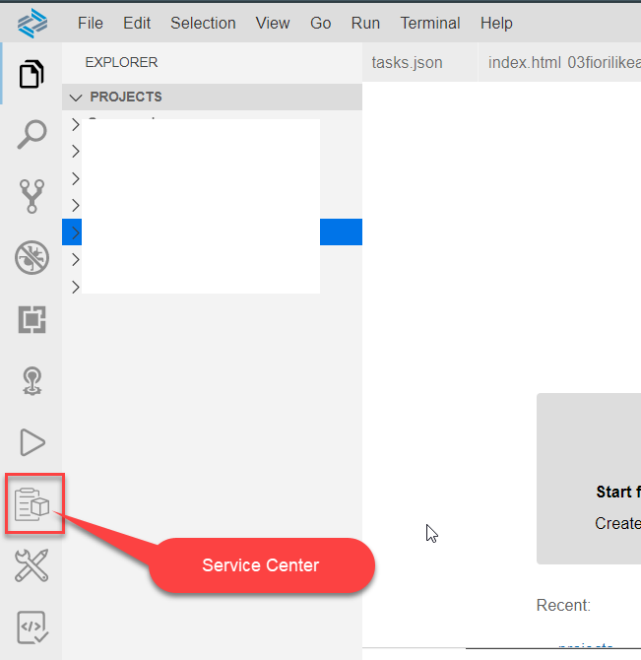
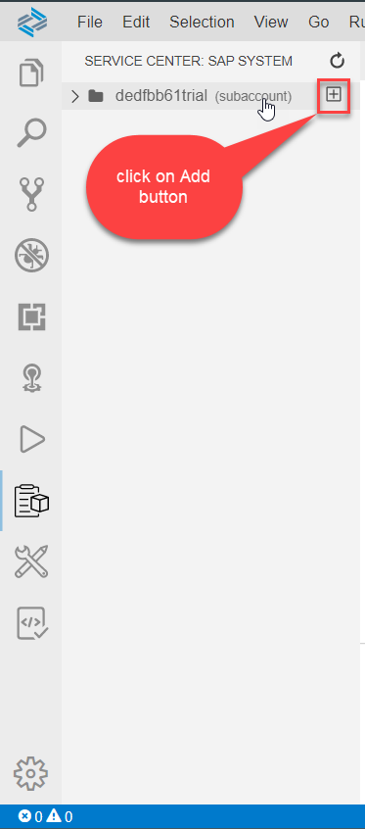
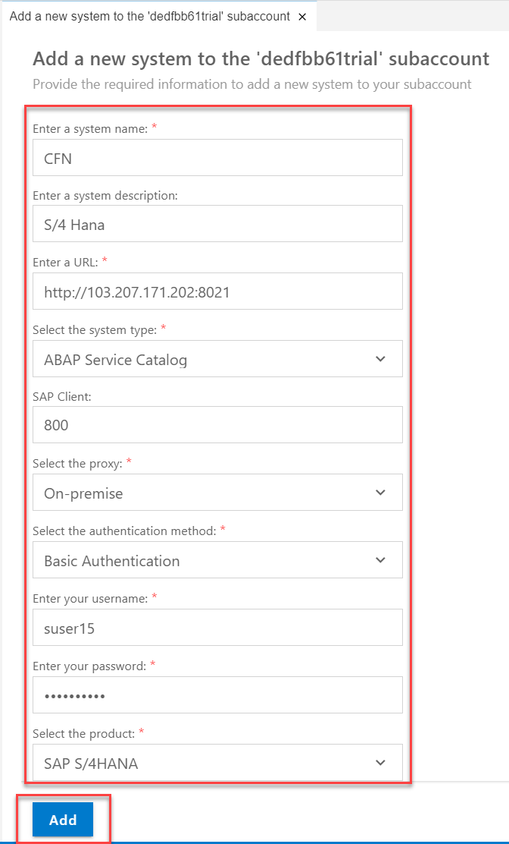
Destination
Go to BAS and Click on Service Center Icon in the Left Vertical Menu Bar and click on add

Slide 12
BAS Fiori App Integration with OData
Step1: Create xs-app.json file in your project folder.
{
"welcomeFile": "/index.html",
"authenticationMethod": "none",
"routes": [
{
"authenticationType": "none",
"csrfProtection": false,
"source": "^/sap/opu/odata/sap/Z_FIRST_XX_SRV/",
"destination": "CFN"
},
{
"source": "^(.*)$",
"target": "$1",
"service": "html5-apps-repo-rt"
}
]
}

Slide 13

BAS Fiori App Integration with OData
Step2: Enhance the manifest.json code
Step3: Go to terminal and open your project folder and run command npm init, it create a package.json file to the project folder
Step4: Add ui5.yaml using ui5 init
Step5: Run the application from run configuration.
Step6: Change the App.view.xml
Step7: Change the Add.view.xml
Step8: Change the Avengers.view.xml
Step9: Change the View1.view.xml
Step10: Change the View2.view.xml
Step11: Change the moreinfo.fragment.xml
Step12: Change the supplierTab.fragment.xml
Step13: Change the popup.fragment.xml
Step14: Change the App.controller.js
Step15: Change the Add.controller.js
Step16: add Avengers.controller.js
Step17: add Basecontroller.js
Step18: Change the View1.controller.js
Step19: Change the View2.controller.js
Step20: Add ui5 init
Step21: Add i18n.properties and formatter.js

Slide 14

End of Day 17

Slide 15

Questions

Slide 16

Anubhav Oberoy

Slide 17


We’re committed to empower you to be
Most Desirable Resource
through powerful training solutions.
We build the workforce of the future.
250+
Corporate Clients
30,000+
Learners Trained
25000+
Learners Placed
FREE WEBINARS
Sign up for free webinars with industry experts every fortnight!
Enroll Now!
Contact us today!
https://anubhavtrainings.com/

Slide 18




More from AnubhavTrainings.com

